Slide 1
Binary Bazaar Online Marketplace
System Development Project
By Liam Corcoran, Lucas Magnien, Nirosh Ratnam, and Yu-Tang Yu
www.binarybazaar.ca

Slide 2
Binary Bazaar – Project Definition
Online marketplace / store application
Cloud SaaS providing online POS for customers of client businesses
Intended to build a community marketplace where grassroots startups can showcase new business identities and products quickly, promoting early feedback
Eventual collation of shopping data for statistical analysis

Slide 3
Risk Assessment
Personnel
Group members may leave the group or fall into a condition where they are not able to reach deadlines
Technology
Tools or strategies may fail due to unforeseen circumstances
Scope
The amount of work required for deadline may be beyond our abilities to accomplish in this term

Slide 4
Risk Compensation
Personnel
Modular phase strategy allowed for task load balancing between group members
Technology
The creation of features was scheduled on an as-needed basis, meaning that the most important work was completed first and refining will occur afterwards
In theory, this allowed us to find out what works early enough to still have time to change strategy or technology
Scope
Creating features in parallel allowed for coaching within the team, which helped with the disparity of abilities within the group

Slide 5
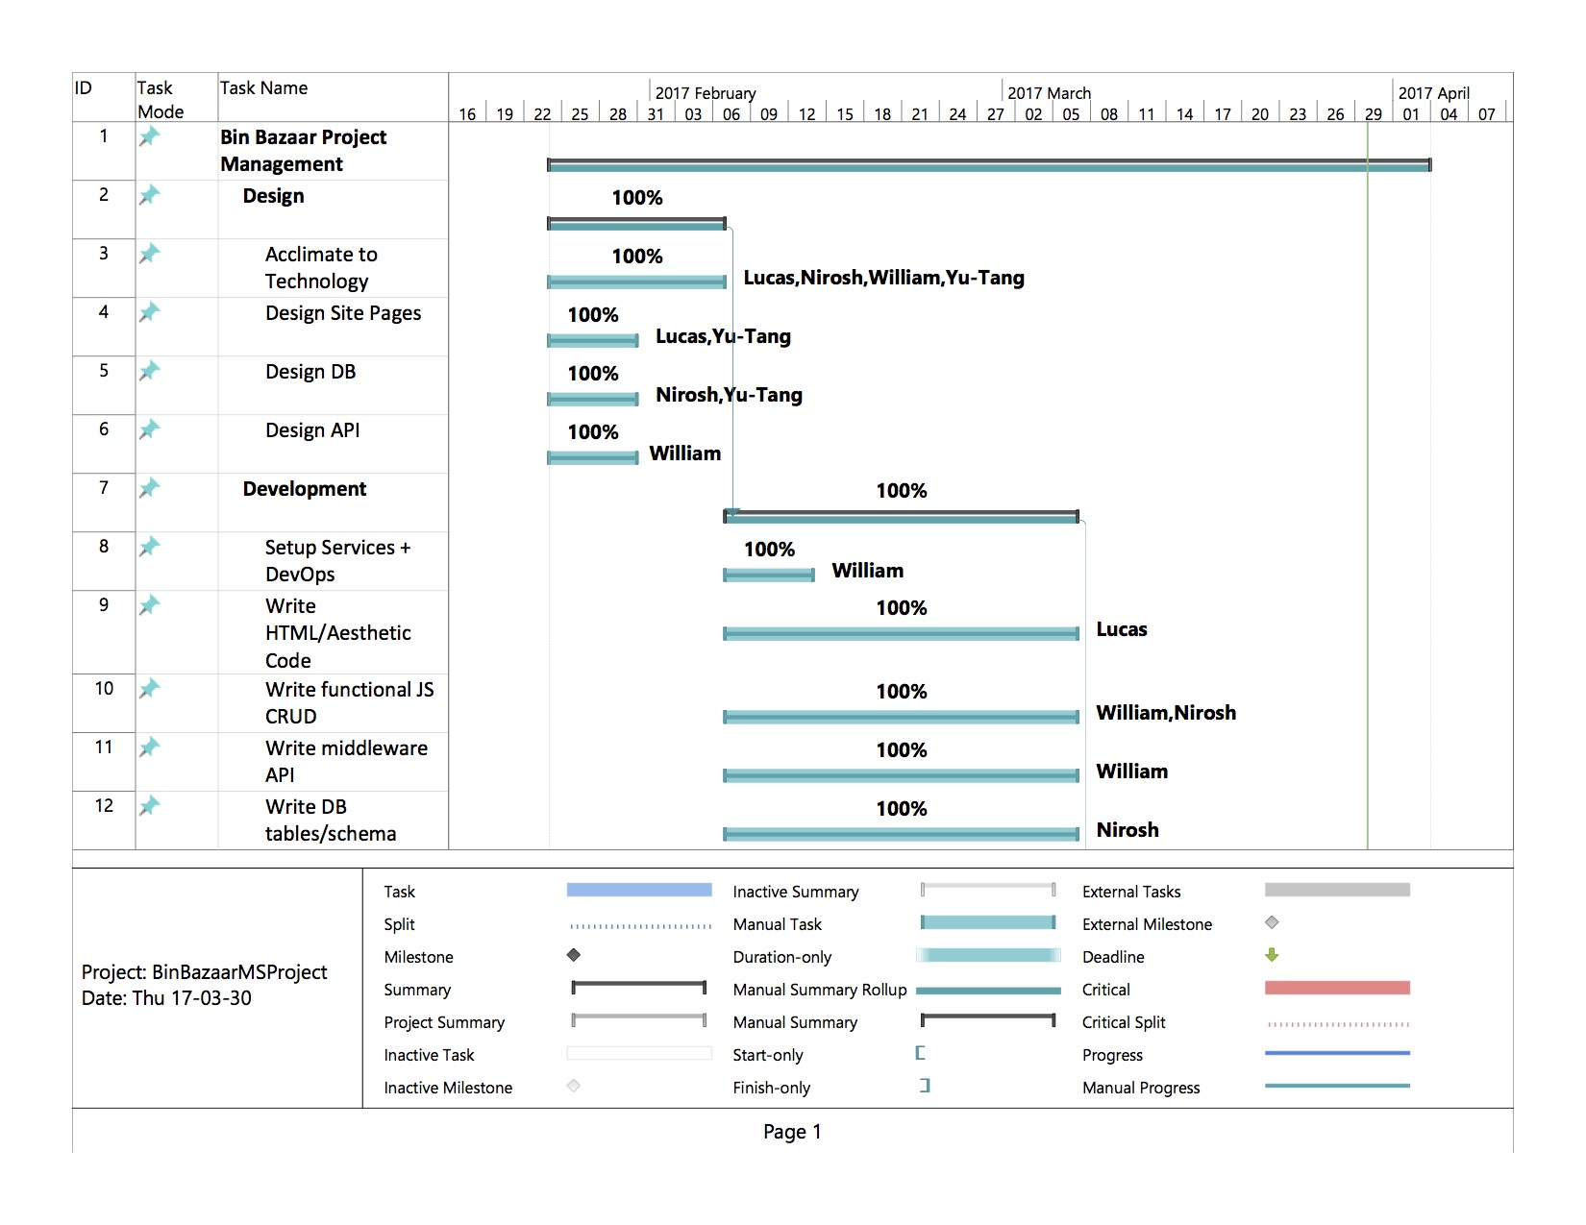
Task Breakdown – Gantt Chart

Slide 6
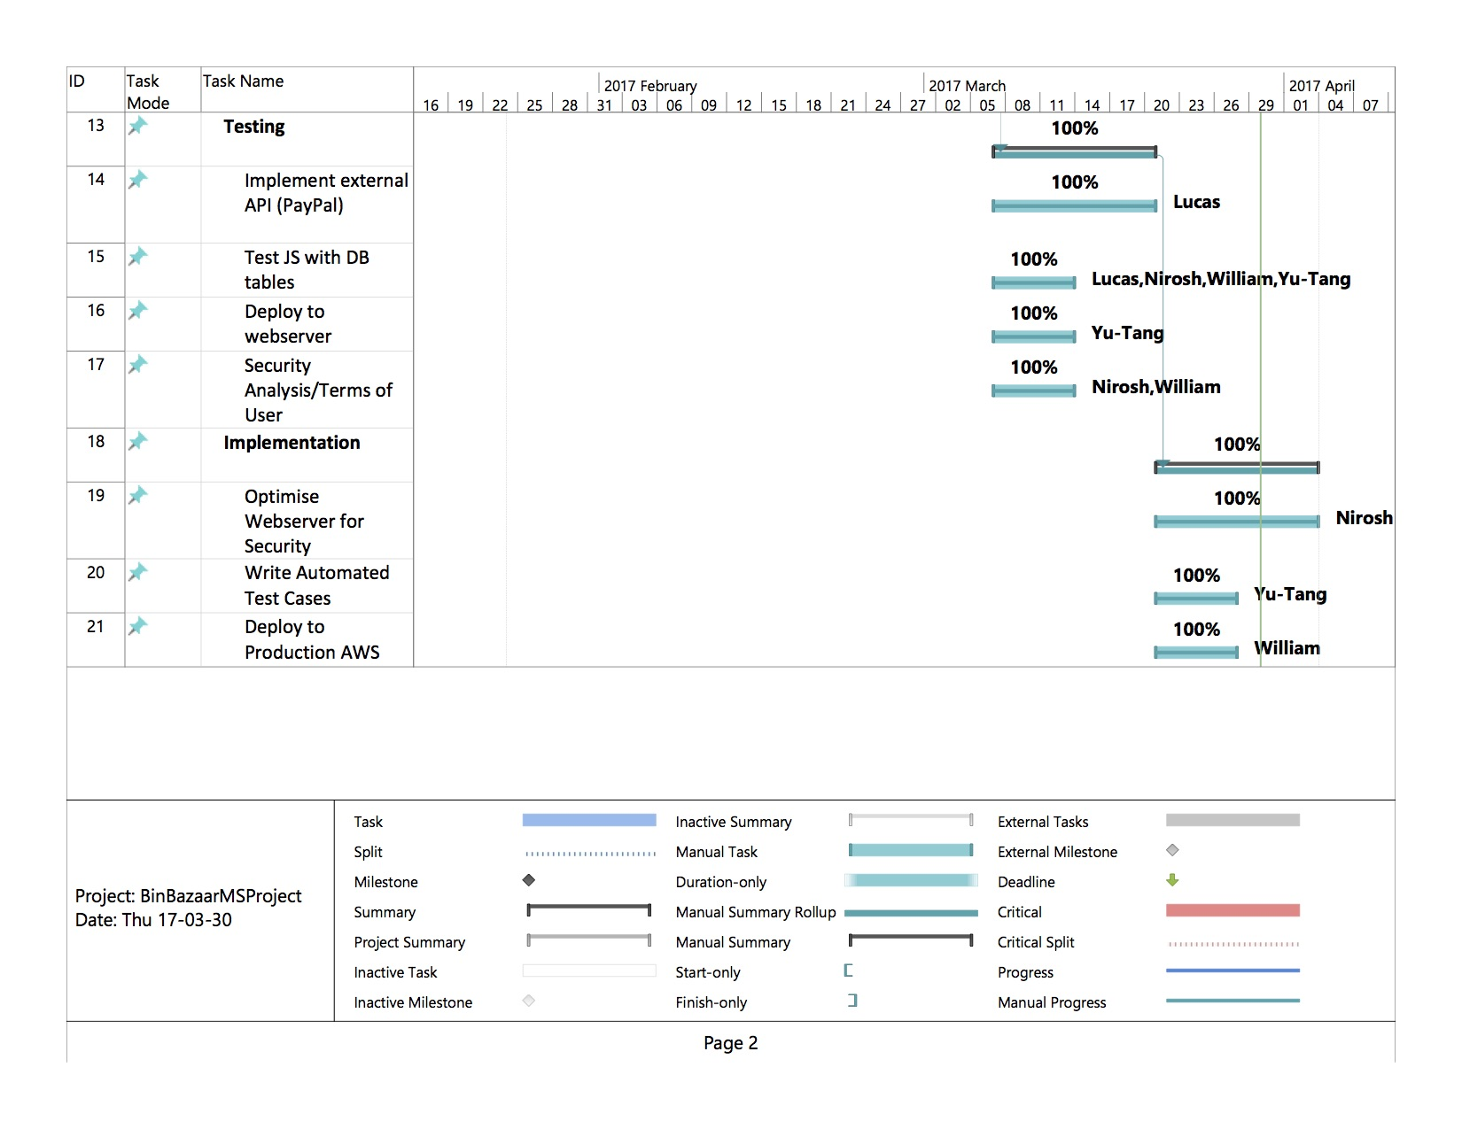
Task Breakdown – Gantt Chart

Slide 7

Progress – Index Page
Navigation bar holds links to common pages such as About, Contact, Sign Up, Login.
Banner may display feature businesses or products, promotions, etc.
Linked images on main page portray business clients and their products.

Slide 8

Progress – Item Page

Slide 9
Progress – Cart Page

Slide 10
Issues
Time was the greatest obstacle (original goals and vision were compromised to meet deadline).
Diversity in group members’ knowledge needed to be addressed (learning new technologies was a challenge).
Maintaining effective task coordination, keeping to a set timeline, was difficult – a practiced skill which a group working together over time would doubtless improve upon.

Slide 11
Conclusion
Group work represents a “meeting of minds”. Working together with others can be challenging, but is also rewarding, and is an essential aspect of the professional world. Every new experience is different, and equally valuable.
Technologies are often treated scholastically in isolation from one another; understanding how they can be integrated to work together as parts of a larger whole can only be achieved through experience.

